Slide 1
The MegaDerm 3000
Team 9
Kristen Hagan
Mahy Hussain
Laura Kenyon
Thomas Leahy

Slide 2
Process Overview

Slide 3
Process Overview
Perform single-image Analysis on every image
Prompt user to crop the ruler and mole
Detect the
lesion border
Perform time-lapse analysis for individual data collected from every image
Border Contour Map
Change in area over time
Change in asymmetry over time
Change in color variation over time
Find the pixel/mm conversion factor
Calculate lesion
area
Prompt user to input image stack
Calculate asymmetry coefficients
Calculate Color
Variation Coefficients

Slide 4
Process Overview
Perform single-image Analysis on every image
Prompt user to crop the ruler and mole
Detect the
lesion border
Find the pixel/mm conversion factor
Data Analysis and Time-lapse
Asymmetry
Border
Color Variegation
Diameter
Evolving
Calculate lesion
area
Prompt user to input image stack
Calculate asymmetry coefficients
Calculate Color
Variation Coefficients

Slide 5
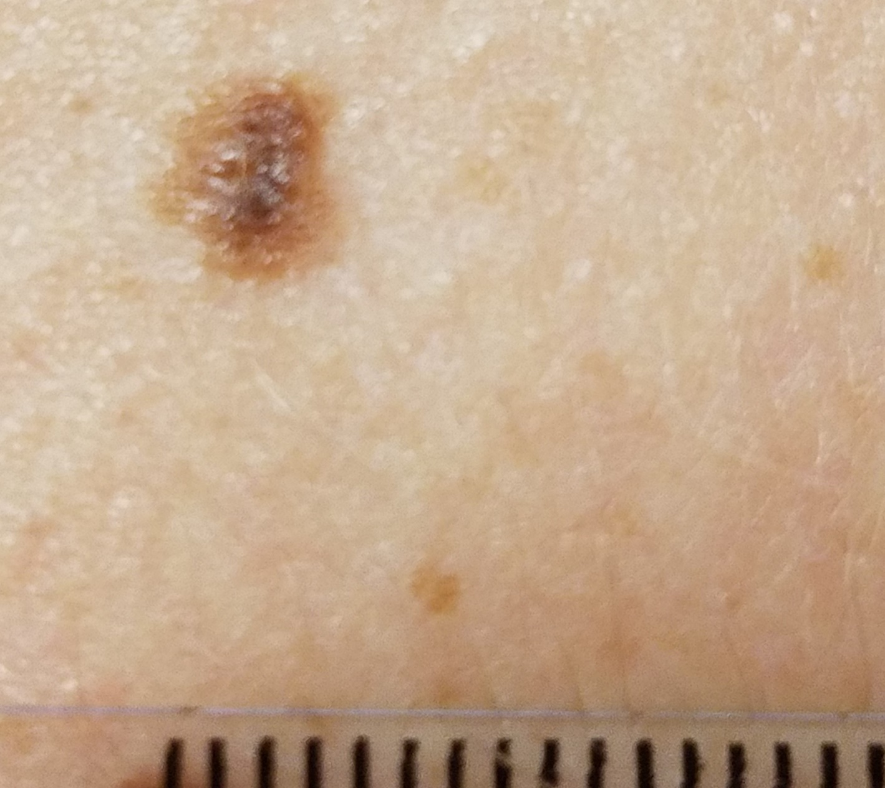
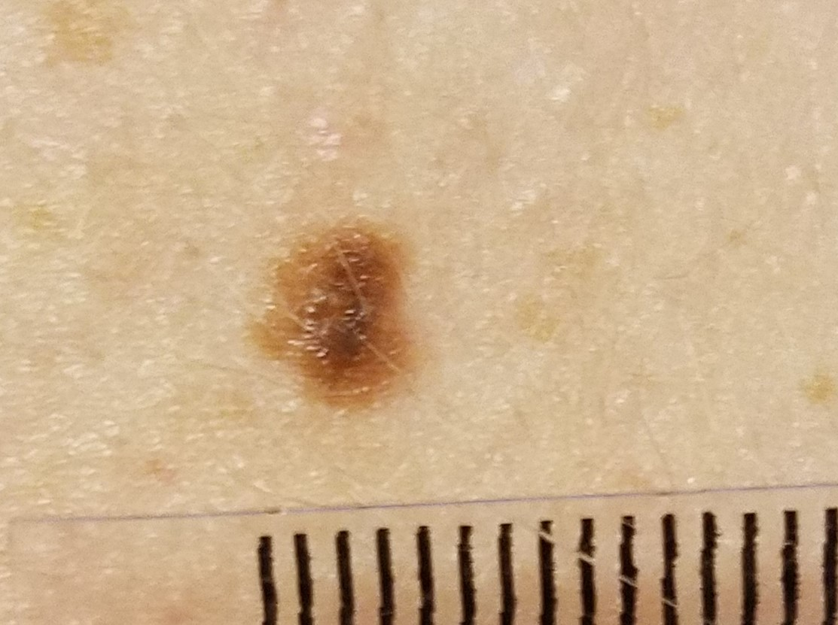
Input Image Stack
Images requires lesion and millimeter ruler at same focal length for pixel-mm conversion factor calculation

Slide 6

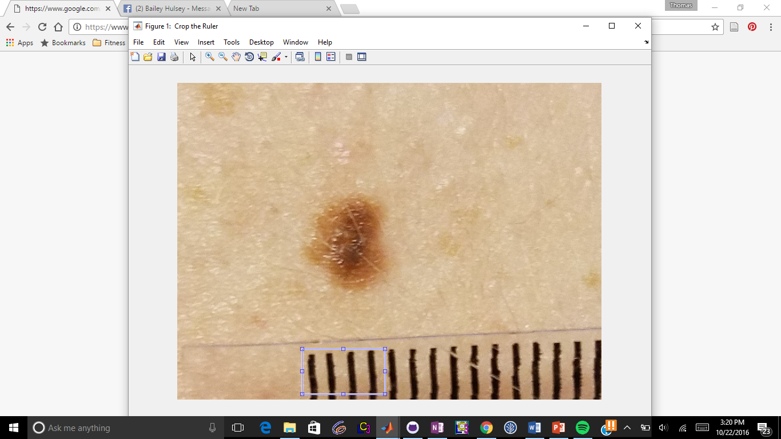
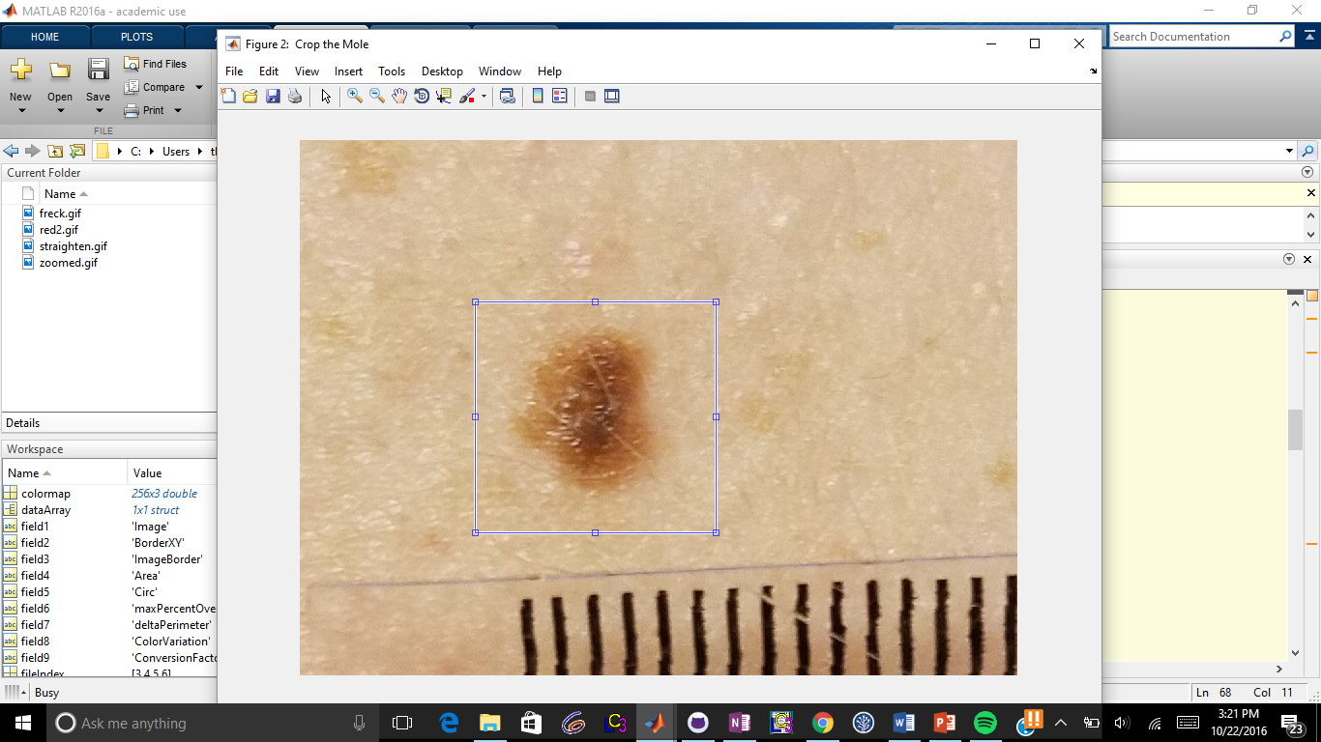
User Input - Cropping
Ruler Crop
Mole Crop

Slide 7
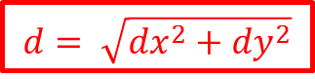
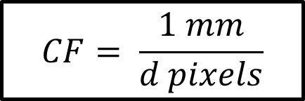
Finding the mm/pixel conversion factor (CF)
$$d= \sqrt{{dx}^{2}+{dy}^{2}}$$
dy
dx
$$CF= \frac{1 mm}{d pixels}$$
Notes:
$$d= \sqrt{{dx}^{2}+{dy}^{2}}$$
$$d= \sqrt{{dx}^{2}+{dy}^{2}}$$
$$CF= \frac{1 mm}{d pixels}$$

Slide 8
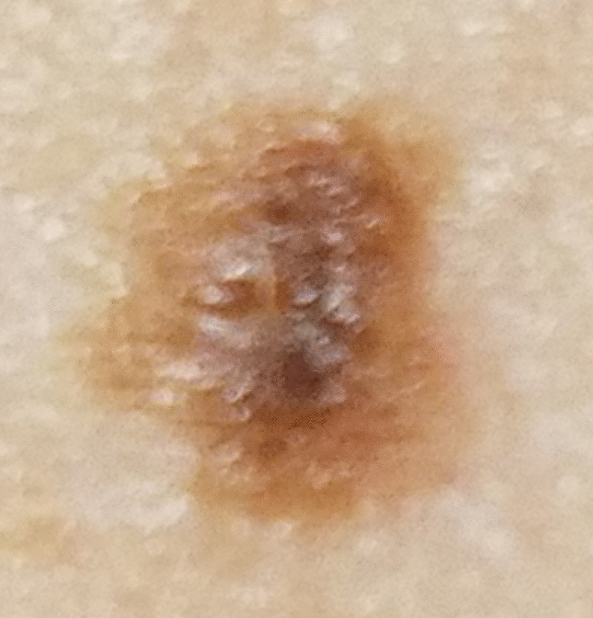
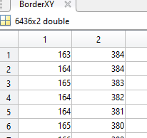
Detecting the lesion border
XY Coordinates for the Border
Binarized Image

Slide 9
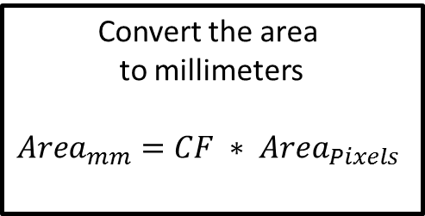
Calculate the lesion area
Binarized Image
Convert the area to millimeters
$${Area}_{mm}=CF ∗ {Area}_{Pixels}$$
Sum the number of pixels considered part of the mole

Slide 10
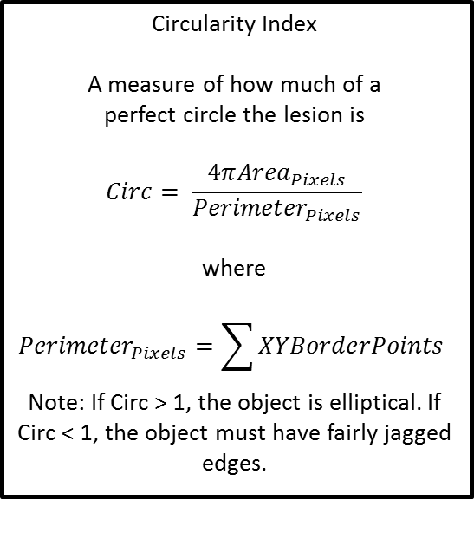
Calculate asymmetry coefficients
Plane of Symmetry Testing
Rotate through θ from 0° to 179°.
Overlap the image across the line of symmetry and calculate the percent match.
Output the highest percent match as the symmetry coefficient
Difference in Elliptical Perimeter
Fit the object to an ellipse based off of major and minor axes
Calculate the difference in perimeters between the two as a percentage (object perimeter as described previously). A higher percentage value means the object has more jagged edges.
Circularity Index
A measure of how much of a perfect circle the lesion is
$$Circ= \frac{4π{Area}_{Pixels}}{{Perimeter}_{Pixels}}$$
where
$${Perimeter}_{Pixels}=\sum{XYBorderPoints}$$
Note: If Circ > 1, the object is elliptical. If Circ < 1, the object must have fairly jagged edges.
θ

Slide 11
Calculate color Variation Coefficients
Kristen do this, idk wat it is

Slide 12
Data Analysis and Time-lapse
Analyzing the ABCDE’s of inputted lesions
Asymmetry
Border
Color
Diameter
Evolving

Slide 13
Data Analysis and Time-lapse
Asymmetry
Output
maxPercentoverlap= 0-33.3%
Warning: lesion asymmetrical, highly suspicious.
Calculate “maxPercentOverlap” from plane of symmetry testing
maxPercentoverlap= 33.3-66.7%
Caution: lesion somewhat asymmetrical, suspicious.
maxPercentoverlap= 66.7-100%
Lesion symmetrical.

Slide 14
Data Analysis and Time-lapse
Border
Output
Warning: lesion has ragged, irregular shape, highly suspicious.
deltaPerimeter= 0-33.3%
Calculate “deltaPerimeter” from difference in elliptical perimeter testing
deltaPerimeter= 33.3-66.7%
Caution: lesion has somewhat irregular shape, suspicious.
deltaPerimeter= 66.7-100%
Lesion has regular, round shape.

Slide 15
Data Analysis and Time-lapse
Color
Output
Warning: color variegated, highly suspicious.
SSI= 0-33.3%
Calculate “SSI” between lesions.
Caution: color somewhat variegated, suspicious.
SSI= 33.3-66.7%
SSI= 66.7-100%
Color evenly distributed.

Slide 16
Data Analysis and Time-lapse
Diameter
Output
Warning: lesion is large in diameter, highly suspicious.
Diameter= > 6mm
Calculate “diameter” from major axis approximation.
Diameter= 4-6mm
Caution: lesion is somewhat large in diameter, suspicious.
Diameter= < 4mm
Lesion has regularly sized diameter.

Slide 17
Data Analysis and Time-lapse
Evolving
Output
Radialgrowthrate > 0.13mm/month
Warning: lesion rapidly growing radially.
Calculate “radialgrowthrate”
Radialgrowthrate= 0.065-0.13mm/month
Caution: lesion slowly growing radially.
Radialgrowthrate < 0.065mm/month
Lesion not growing radially.
Verticalgrowthrate > 0.065mm/month
Warning: lesion rapidly growing vertically.
Calculate “verticalgrowthrate”
Verticalgrowthrate= 0.0325-0.065mm/month
Caution: lesion slowly growing vertically.
Verticalgrowthrate < 0.0325mm/month
Lesion not growing vertically.

Slide 18
Summary
Characteristic | Results (Warning, Caution, or Benign) | Score
Asymmetry | Ex. Benign (94%) | 94
Border | Ex. Warning (22%) | 22
Color Variegation | Ex. Caution (63%) | 63
Diameter | Ex. Benign (3mm) | 83.3
Evolving- radially | Ex. Warning (.15mm/month) | 23.1
Evolving-vertically | Ex. Caution (.04mm/month) | 59.0
Summary | Benign- 2 Caution- 2 Warning- 2 | 57.4
Recommendation 0-25: Most likely lesion is benign. Monitor monthly. 25-50: Questionable lesion. Closely monitor biweekly. 50-75: Suspicious lesion, consult a doctor to determine if a biopsy is necessary. 75-100: Highly suspicious lesion, consult a doctor immediately about seeking a biopsy.
Notes:
Diameter:
<2-4 score of 100-66.7
4-6 score of 66.7-33.3
6->8 score of 33.3-0
Score= 100-16.667*(diameter-2) (unless <2 or >8)
Evolving-radially:
0-.065 score of 100-66.7
.065-.13 score of 66.7-33.3
.13- >.195 score of 33.3-0
Score= 100-512.8205*(diameter)
Evolving-vertically:
0-.0325 score of 100-66.7
.0325-.065 score of 66.7-33.3
.065- >.0975 score of 33.3-0
Score= 100-1025.641*(diameter)

Slide 19
Timelapse Creation:
Border Contour
Use CF to scale all images up to the maximum size.
Interpolate data points in between defined points created by scaling.
Scan through lesion cropped images to find the largest image
There might be something here to make it an image???
Plot borders on the same map as a contour map

Slide 20
Time-lapse Creation:
Area
Image1:
Calculate lesion
area
Create data array.
 | Value
1 | Area
2 | Area
Image 2:
Calculate lesion
area
Notes:
How does this fit into ABCDE?

Slide 21
Time-lapse Creation:
Asymmetry
Calculate asymmetry coefficients

Slide 22
Time-lapse Creation:
Color Variation
Kristen do this, idk wat it is

Slide 23
Validation

Slide 24
Future Directions

Slide 25
Improve accuracy of color variegation calculation
Standardize image capture with molescope device
Integrate device with user-friendly smartphone application
Test more data sets to validate image analysis
Advertise application, find investors

